Slide 1
Week 3a
COMPUTATIONAL MATHEMATICS

Slide 2
Outline
Descriptive Statistics
Using scipy.stats and numpy package for statistics

Slide 3
Session Learning Outcomes
Upon completion of this session, you should be familiar to work with some numpy functions for computing statistic descriptive, module numpy.random for random numbers, and scipy.stats for more complete statistical analysis functions.

Slide 4
Reference
Robert Johansson. (2015). Numerical Python: A Practical Techniques Approach for Industry. Apress. Chapter 13: Statistics
You may also read:
https://anaconda.org/fe_gunawan/describing-data-with-statistics/notebook
You should read through the chapter and try the codes.

Slide 5
Descriptive Statistics
Descriptive statistics are widely used to provide numerical descriptions of a large dataset. Most popular descriptive-statistic pairs are:
Mean and standard deviation
Median and IQR
Mode and range

Slide 6
Key Measures on Describing Data
 | Moment | Non-moment based location parameters
Center | Mean | Mode, median
Spread | Variance (standard deviation) | Range, Interquartile range
Skew | Skewness | --
Peaked | Kurtosis | --
Moments are a set of statistical parameters to measure a distribution

Slide 7
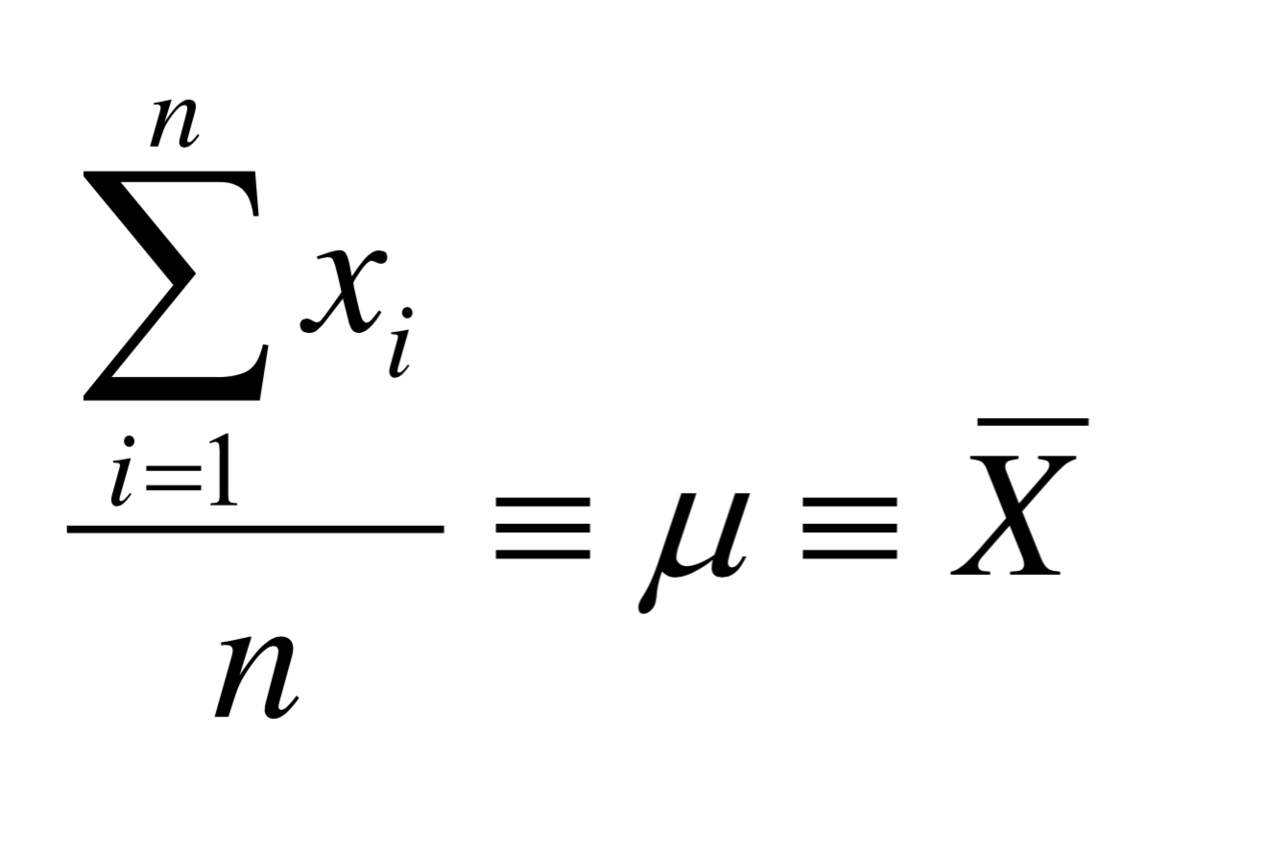
Mean

Slide 8
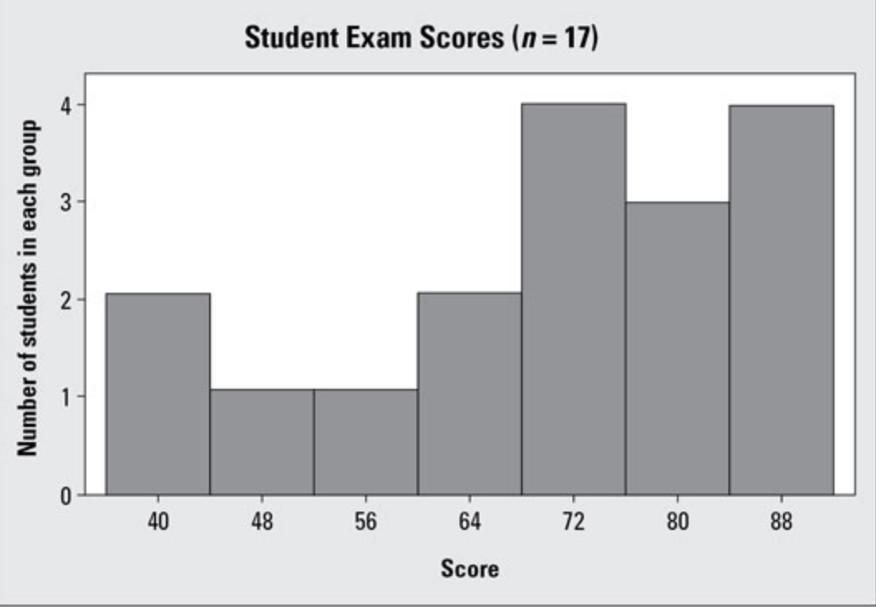
Guess the Mean

Slide 9
Guess the Mean
70.11

Slide 10
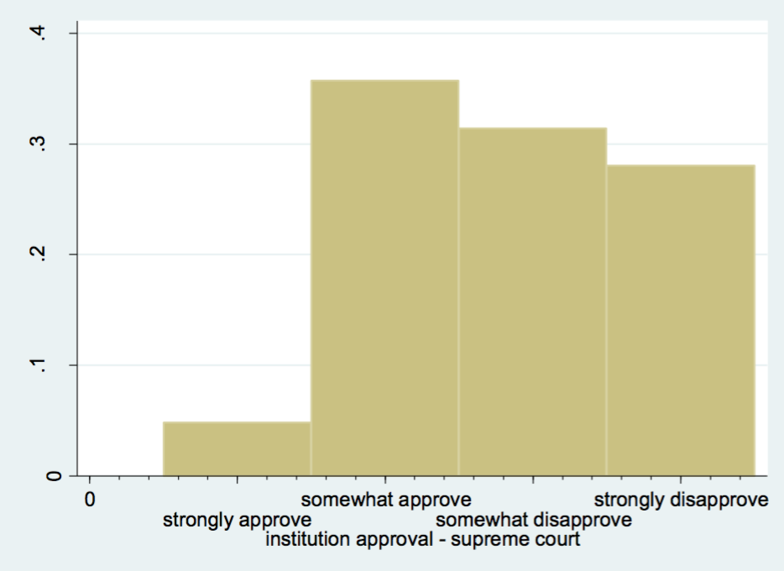
Guess the Mean

Slide 11
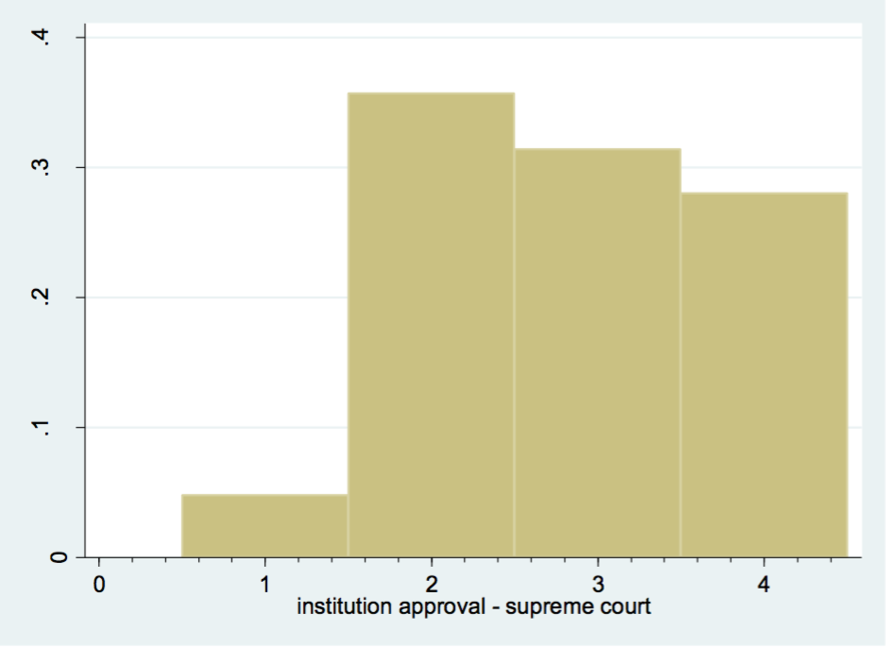
Guess the Mean
0.35
0.32
0.28
0.05

Slide 12
Guess the Mean
2.8
=(0.05*1) + (0.35*2) + (0.32*3) + (0.28*4) = 2.8 / (0.05+0.35+0.32+0.28)

Slide 13
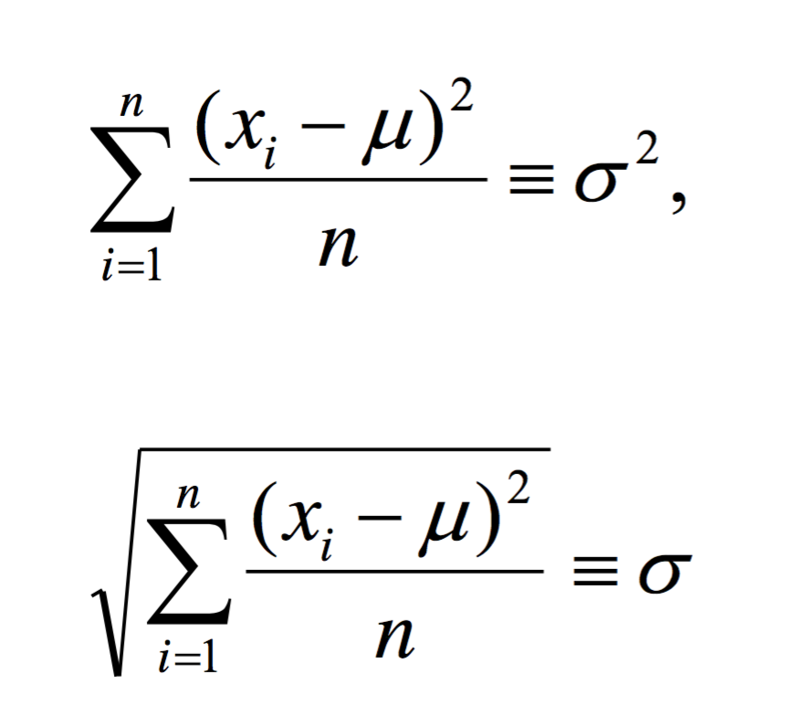
Variance & Standard Deviation of a Population

Slide 14
Why Standard Deviation Important?
For example,
if you are told that the average starting salary for someone working at Company Statistix is $70,000, you may think, “Wow! That’s great.”
But if the standard deviation for starting salaries at Company Statistix is $20,000,
that’s a lot of variation in terms of how much money you can make
if the standard deviation was only $5,000, you would have a much better idea of what to expect for a starting salary at that company.
more appealing, isn’t it?
it’ll be a much more informed decision once you realize standard deviation matters.

Slide 15
Why Standard Deviation Important?
Without the standard deviation, you can’t compare two data sets effectively.
Suppose two sets of data have the same average; does that mean that the data sets must be exactly the same?
Not at all.
For example, the data sets 199, 200, 201 and 0, 200, 400 both have the same average (200) yet they have very different standard deviations.
The first data set has a very small standard deviation (s=1) compared to the second data set (s=200).

Slide 16
Standard Deviation & Variance
For example, given the data:
9, 2, 5, 4, 12, 7, 8, 11, 9, 3, 7, 4, 12, 5, 4, 10, 9, 6, 9, 4
Calculate the mean of the data = 7
Subtract the mean from each data point, then square them
= 4, 25, 4, 9, 25, 0, 1, 16, 4, 16, 0, 9, 25, 4, 9, 9, 4, 1, 4, 9
Calculate the mean of the squared differences
That’s you variance = 8.9
If you want to know the standard deviation, just square root of the variance = 2.98

Slide 17
Non-moment based location parameters
Mode
Median

Slide 18
Mode
Mode is the most frequently occurring value in a dataset.
How to Find the Mode
Collect and organize the data from a dataset.
Determine all the distinct values in a dataset.
Count the frequency of occurrence for each distinct value.
The most frequent value(s) is the mode.

Slide 19
Mode
In addition, it can be easily found using the distribution graph or histogram.
Graphically, it is represented as the peak point on the distribution graph or the tallest bar on the histogram.
The mode is rarely an informative statistic about the central tendency of the data.
It’s most useful in describing the “typical” observation of a categorical variable

Slide 20
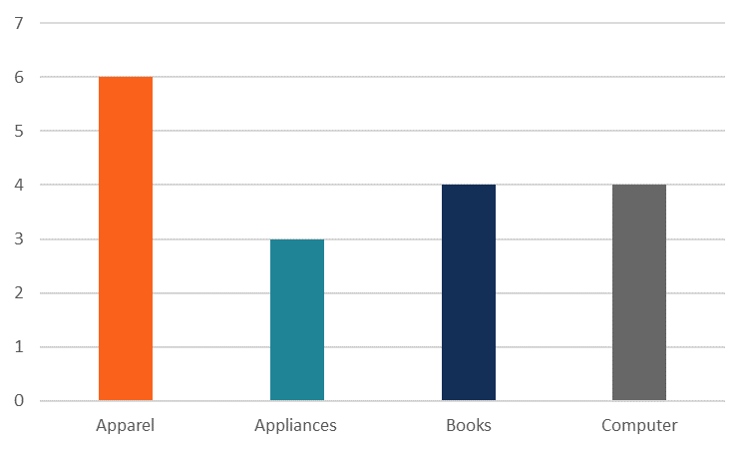
Guess the Mode
From the chart, we can clearly see that the apparel category is the mode in the dataset.

Slide 21
Mode using scipy.stats
from scipy import stats
import numpy as np
a = np.array([[6, 1], [3, 1], [3, 1]])
stats.mode(a)

Slide 22
Median
What is the Median?
The median is the middle number in a sorted, ascending or descending, list of numbers and can be more descriptive of that data set than the average.
When there are two middle numbers, the median is the mean of these two numbers.

Slide 23
Guess the Median
Consider the data set below, which might correspond to the incomes (in thousands of dollars) of a certain group of people.
{24, 42, 64, 38, 49, 30, 34, 29, 2350, 1932, 61, 52, 51, 19, 28}

Slide 24
Guess the Median
Sort them and get the middle one
{19, 24, 28, 29, 30, 34, 38, 42, 49, 51, 52, 61, 64, 1932, 2350}
The median income does a much better job of expressing the central tendency of the data.
If we were to ignore the two individuals with extremely high incomes
the mean income of the remaining individuals to be about 40,
close to the median income.

Slide 25

Median using Numpy
import numpy as np
a = np.array([24, 42, 64, 38, 49, 30, 34, 29, 2350, 1932, 61, 52, 51, 19, 28])
np.median(a)

Slide 26
Lopsidedness and peakedness
Skewness
Kurtosis

Slide 27
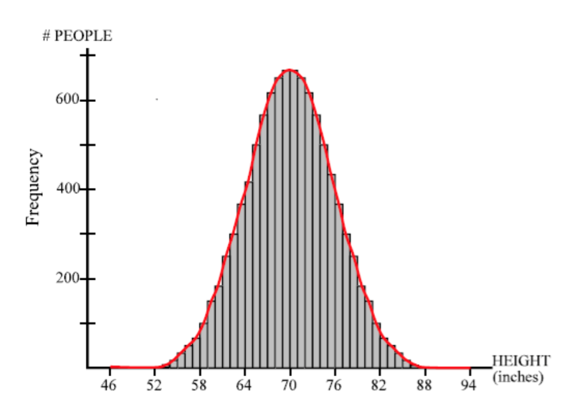
Normal Distribution Example
Example:
IQ
SAT points
Height
Symmetrical
Mean = median = mode

Slide 28
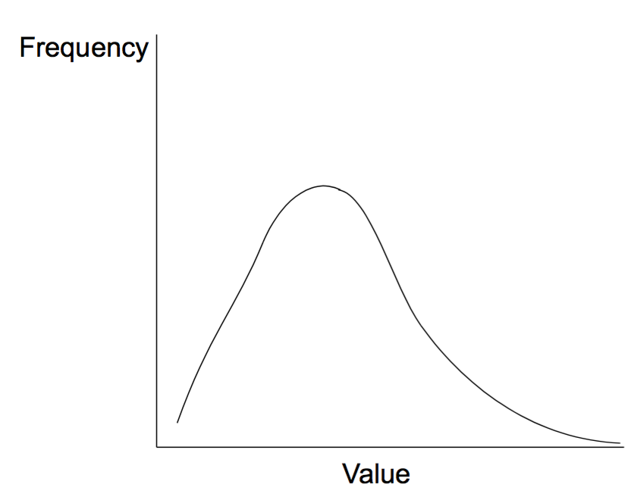
Skewness: Asymmetrical distribution
Example:
• Income • Populations of countries
• Age of the undergraduates
“Positive skew”
“Right skew”

Slide 29
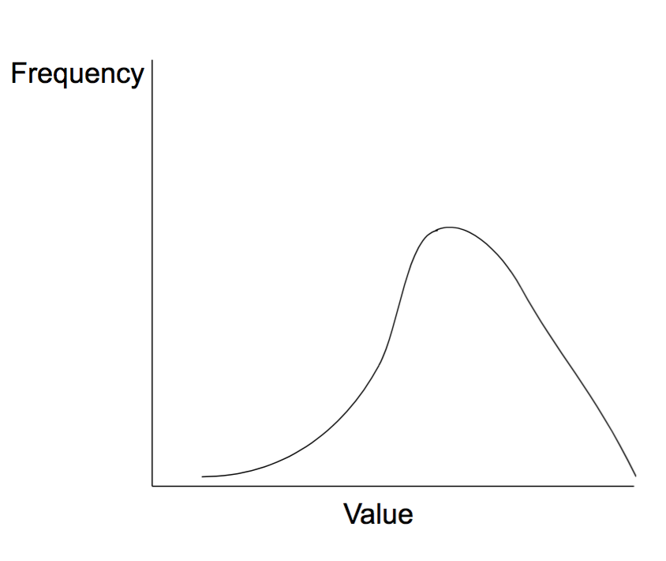
Skewness: Asymmetrical distribution
Example:
GPA of the students
Age of the faculty
“Negative skew”
“Left skew”

Slide 30
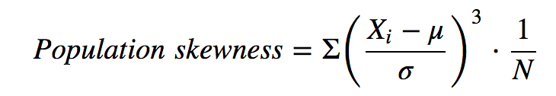
Skewness
The formula to find skewness manually is this:
If the histogram is skewed left, the mean is less than the median.
If the histogram is skewed right, the mean is greater than the median.

Slide 31
Skewness
Score | Mean | Population SD | Z = score – mean / SD | Z Cubed (ZC)
3 | 2.33 | 1.07 | 0.62 | 0.24
1 | 2.33 | 1.07 | -1.24 | -1.91
2 | 2.33 | 1.07 | -0.31 | -0.03
3 | 2.33 | 1.07 | 0.62 | 0.24
1 | 2.33 | 1.07 | -1.24 | -1.91
1 | 2.33 | 1.07 | -1.24 | -1.91
4 | 2.33 | 1.07 | 1.55 | 3.73
2 | 2.33 | 1.07 | -0.31 | -0.03
2 | 2.33 | 1.07 | -0.31 | -0.03
2 | 2.33 | 1.07 | -0.31 | -0.03
2 | 2.33 | 1.07 | -0.31 | -0.03
2 | 2.33 | 1.07 | -0.31 | -0.03
5 | 2.33 | 1.07 | 2.48 | 15.27
2 | 2.33 | 1.07 | -0.31 | -0.03
3 | 2.33 | 1.07 | 0.62 | 0.24
Sum ZC |  |  | 13.78
Population Size |  |  | 15
Population Skewness (Manual) |  |  | = 13.78/ 15 = 0.92

Slide 32

Skewness
Using Scipy stats is easy
from scipy import stats
import numpy as np
a = np.array([3,1,2,3,1,1,4,2,2,2,2,2,5,2,3])
stats.skew(a)

Slide 33
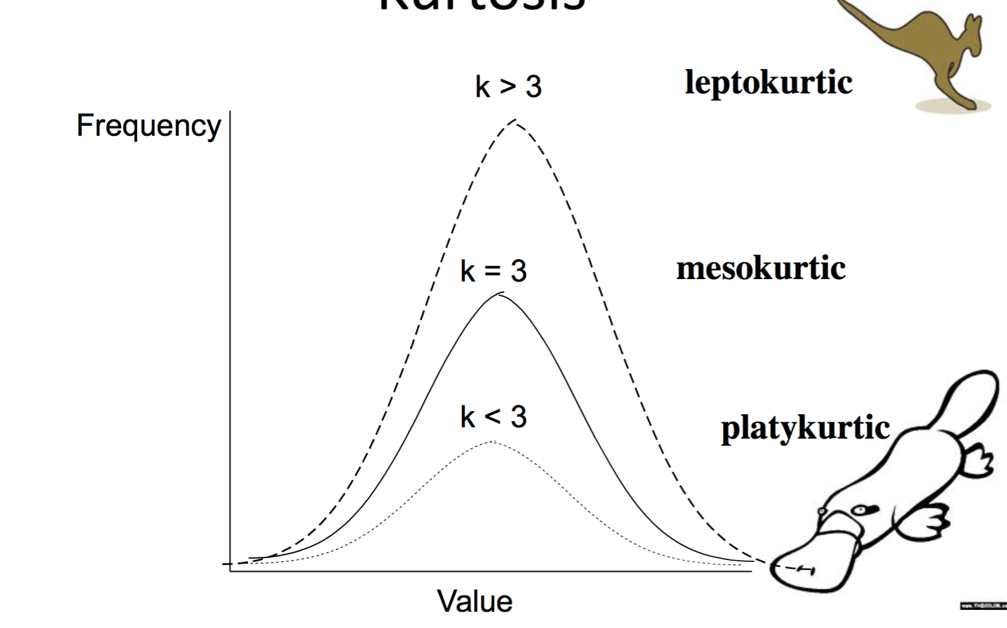
Kurtosis
Kurtosis is a measure of the "tailedness"

Slide 34
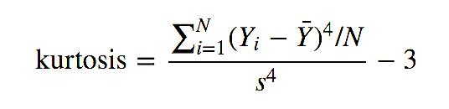
Kurtosis
The kurtosis for a standard normal distribution is three. For this reason, some sources use the following definition of kurtosis (often referred to as "excess kurtosis"):
This definition is used so that the standard normal distribution has a kurtosis of zero. In addition, with the second definition positive kurtosis indicates a "heavy-tailed" distribution and negative kurtosis indicates a "light tailed" distribution.

Slide 35
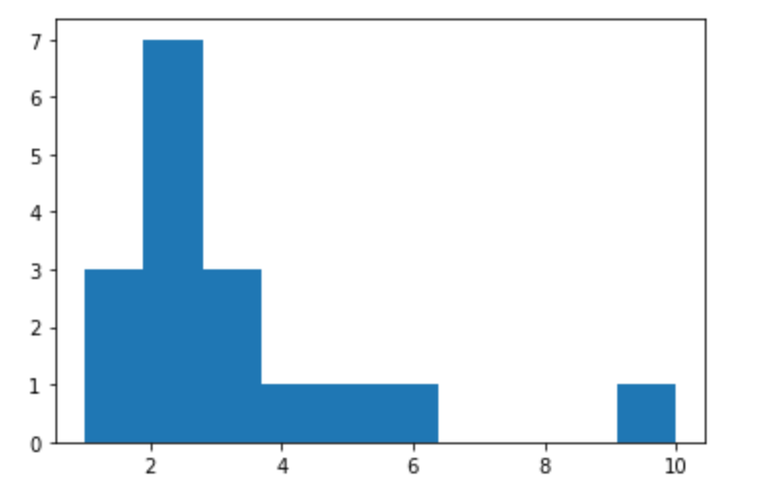

Kurtosis using scipy.stats
from scipy import stats
import numpy as np
import matplotlib.pyplot as plt
a = np.array([3,1,2,3,1,1,4,6,10,2,2,2,2,2,5,2,3])
stats.kurtosis(a)
plt.hist(a)
Try to change the data to reflect the different kurtosis

Slide 36
Descriptive Statistics (cont’d)
Every instance of the ndarray object is enriched with functions, providing those basic statistics, almost all. Those functions are the following. When you create a numpy object, we get its stats too.
'argmax’ 'argmin',
'max’ 'mean',
'min’ 'std',
'sum’ 'var',

Slide 37
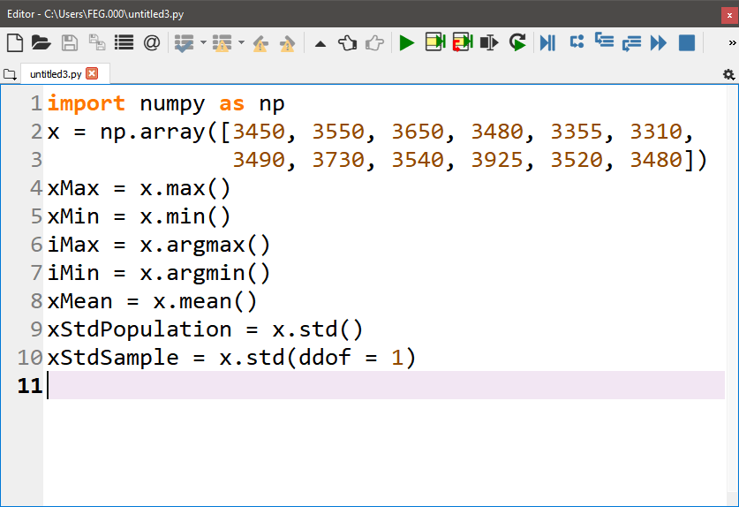
Descriptive Statistics (cont’d)
Python Codes
Results
xMax = 3925
xMin = 3310
iMax = 9
iMin = 5
xStdPopulation = 158.600651
xStdSample = 165.659779
Notes:
In this slides, we create data and store them in x ndarray. Subsequently, we use the instance methods to obtain some statistical descriptions. Pay attention that as for the standard deviation and variance, the default are for population. You have to set different in degree of freedom (ddof) to 1 to obtain the sample variance and standard deviation.

Slide 38
Random Numbers
Random numbers and probability distributions can be obtained from function within the module numpy.random. However, scipy.stats module is more complete.
Notes:
The module scipy.stats is derived from the module numpy.random.

Slide 39
Random Numbers (cont’d)
Issue: `numpy.random?’ to obtain the list of the functions. Some are:
standard_normal Standard normal distribution.
standard_t Standard Student's t-distribution.
Internal functions
==============================================================================
get_state Get tuple representing internal state of generator.
set_state Set state of generator.
==================== =========================================================
Notes:
To know all functions within the module, issue ‘np.random?’ to obtain a list of functions.

Slide 40
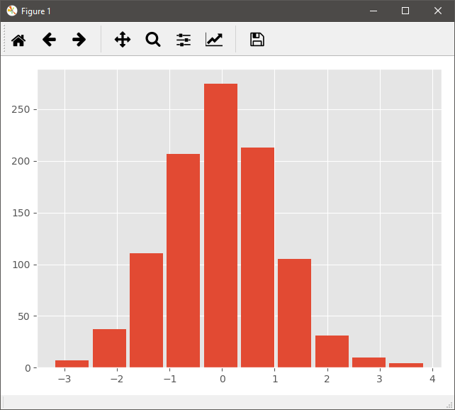
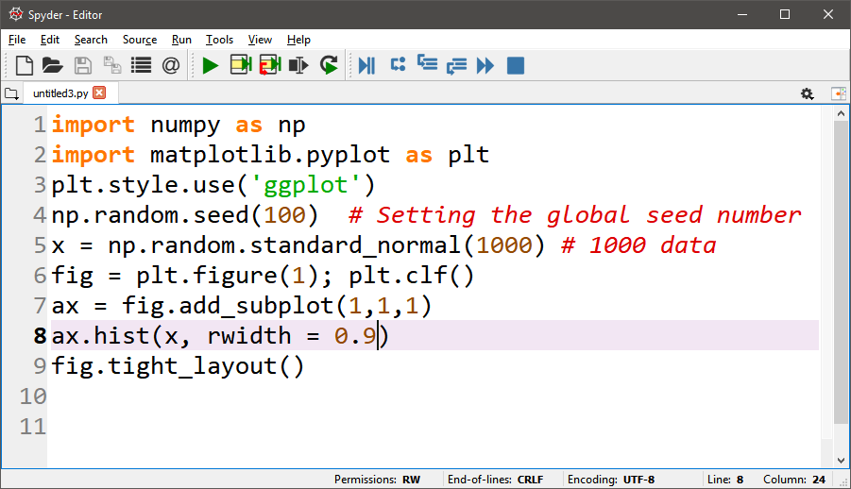
Examples of Random Numbers
Python Codes
Results
Notes:
In this slide, we create an array of random number following the standard normal distribution and store them in variable x. We plot the data in the form of the histogram. To know further about the histogram, invoke ‘ax.hist?’ in the python shell.

Slide 41
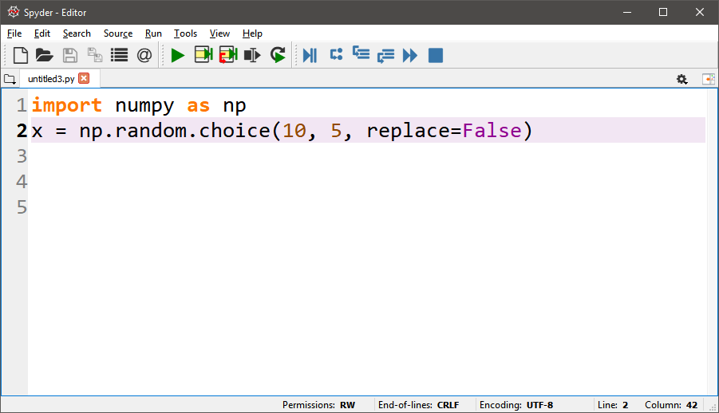
Example of Random Numbers
You can produce integer random numbers without replacement:
x = [8, 9, 4, 2, 3]
Notes:
The function numpy.random.choice allows to generate integer random numbers with uniform probability distribution, which are important for sampling process.

